Slide 1
LƯU Ý TRÌNH BÀY PPT
Size chữ tối thiểu: 24
Font: Times New Roman
Hạn chế quá nhiều chữ (10 dòng chữ/slide)
Bổ sung nhiều hình ảnh minh họa
Hạn chế các ứng dụng chuyển động (slide, chữ, hình,..)
Nếu có Hình hoặc Bảng cần minh hoạ thì phải đánh số giống như trong bài viết.
Tên Bảng ở phía trên bảng; tên Hình ở phía dưới hình.
Trong các slide trình bày kết quả - thảo luận: chỉ thể hiện Bảng kết quả, không viết phần biện luận (trong bài viết luận văn) vào slide.
(Chú thích (nếu có): dưới bảng, in nghiêng, size 18)

Slide 2

PLANT IDENTIFICATION SYSTEM
CAN THO UNIVERSITY
COLLEGE OF INFORMATION AND
COMMUNICATION TECHNOLOGY
***
GRADUATION THESIS
BACHELOR OF ENGINEERING IN
INFORMATION TECHNOLOGY
(HIGH-QUALITY PROGRAM)
Advisor :
Associate Prof. Dr. Nguyen Thai Nghe
Student :
Nguyễn Duy Khang
Student ID : B1910652
Class: 2019-2023 (K45)
Notes:
I would like to sincerely thank my advisor Associate Prof. Dr. Nguyen Thai Nghe for his wholehearted guidance, assistance, and favorable conditions for me to complete my thesis.

Slide 3
CONTENT REPORTS
1. General introduction to the topic.
2. Research contents.
3. Plant classification model.
4. System description and application demo.
5. Development directions.

Slide 4
1. GENERAL INTRODUCTION
The problem of the study:
Identifying plant species can be a challenging task for individuals without expert knowledge.
Manual identification methods are often time consuming and do not always provide accurate results.
Reason for choosing the topic:
Brings abundant knowledge, skills, and experience in both machine learning and mobile application development on the iOS platform.
Provide practical value to the community.

Slide 5
1. GENERAL INTRODUCTION
The purpose of the study:
Use the Inception V3 deep learning model to create a powerful plant recognition system.
Deploy this system on an iOS platform mobile application developed using the Swift programming language.
Provide a user-friendly tool that helps individuals to quickly and accurately recognize plants in their environment, contributing to environmental awareness and conservation efforts.

Slide 6

2. RESEARCH CONTENTS
Overview of machine learning:
Convolutional Neural Network - CNN.
Inception V3 model.
Model evaluation method.
System application building technology: Core ML Tools, Core Data, Swift language, WikipediaKit .
$$accuracy= \frac{correct predictions}{all predictions}$$
Notes:
-

Slide 7
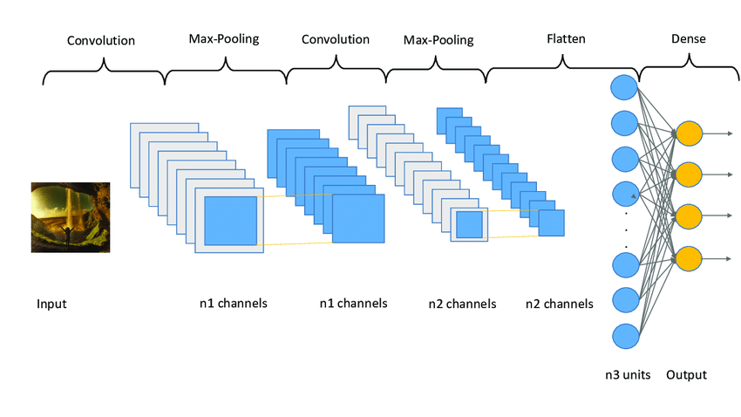
2. RESEARCH CONTENTS
Convolutional Neural Network - CNN:
Figure 1. Convolutional Neural Network Architecture
Notes:
-

Slide 8
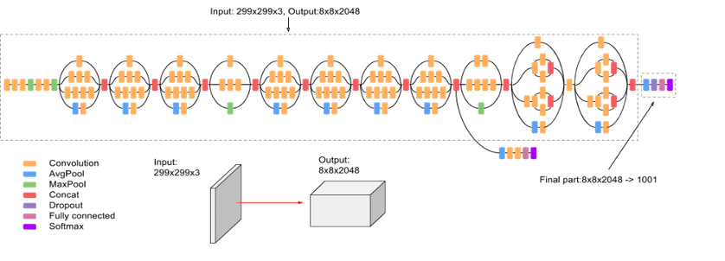
2. RESEARCH CONTENTS
Inception V3 model:
Figure 10. The architecture of the Inception V3 model
Notes:
-

Slide 9

2. RESEARCH CONTENTS
Model evaluation method:
$$accuracy= \frac{correct predictions}{all predictions}$$
Notes:
-

Slide 10
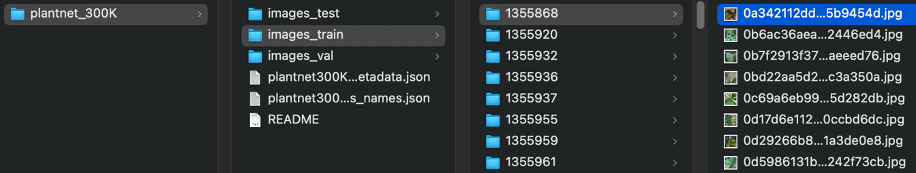
3. PLANT CLASSIFICATION MODEL
PlantNet-300K dataset:
306,146 image, 1,081 different classes.
80% training set, 10% validation set, and 10% test set.
The dataset has a high-class imbalance.
The dataset contains ambiguity and uncertainty.
Figure 11. PlantNet-300K dataset structure
Notes:
- The dataset has high class imbalance with 80% of classes only representing 11% of the total number of images.
- Images collected under sub-optimal conditions.
- Difference species producing visually similar flowers that are challenging to distinguish
- Images captured from different perspectives

Slide 11
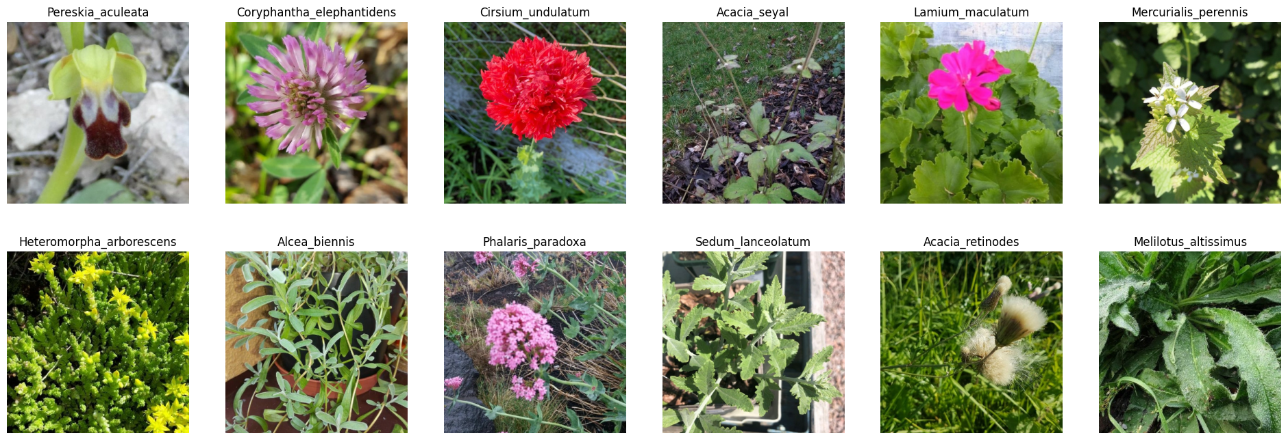
3. PLANT CLASSIFICATION MODEL
Dataset preprocessing:
Replace the entire folder name with the class name.
The remaining data has 1,019 different classes.
Resize 360 x 360.
Figure 13. The example images after being processed
Notes:
- There are 2 or 3 folders with the same class name

Slide 12
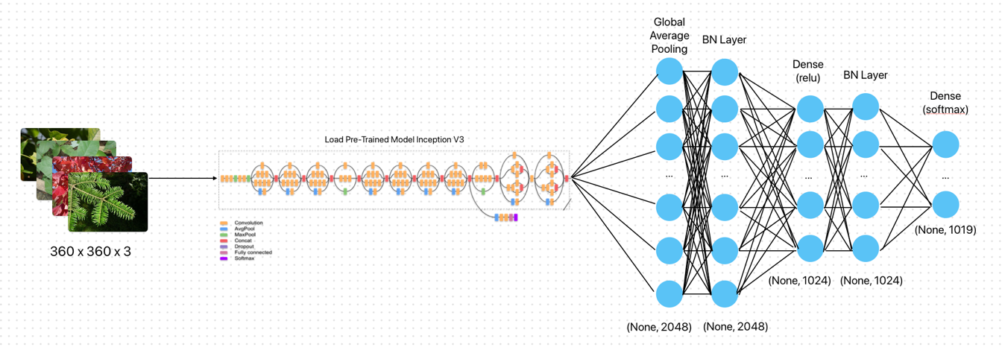
3. PLANT CLASSIFICATION MODEL
Architecture of the plant classification model:
Figure 14. The plant classification model using pre-trained Inception V3
Notes:
- The input image has dimensions of 360x360.
- Use the Inception V3 model as a pre-trained base on the ImageNet dataset to learn features from images
- The output is then passed through a GlobalAveragePooling2D layer. This layer converts each feature matrix into a single value by taking the average of all values in the matrix.
- BatchNormalization is applied after the GlobalAveragePooling2D layer to normalize the output and stabilize the learning process.
- Next is a dense layer with 1024 units and a ReLU activation function.
- A Batch Normalization layer is applied to normalize the output before it is fed into the final dense layer.
- The last layer is a dense layer with softmax activation to perform classification for the classes in the dataset, with a total of 1019 classes.

Slide 13
3. PLANT CLASSIFICATION MODEL
Parameters of the plant classification model :
Table 2. Parameters of the plant classification model
No. | Parameter | Value | Description
1 | input_shape | (360, 360, 3) | Shape of the input images
2 | batch_size | 64 | The parameter determining the number of samples to be processed in one training iteration
3 | learning_rate | 1x10⁻⁴ | The hyperparameter that governs the extent of adjustments to the model in response to the estimated error during each update of the model weights.
4 | rescale | 1./255 | Rescaling factors for the pixel values of the images
5 | dense_units | 1024 | Number of units in the dense layer
6 | num_classes | 1019 | Number of classes in the classification task
7 | epochs | 5 | The hyperparameter determines the number of times I pass all the data in the training dataset through the neural network

Slide 14
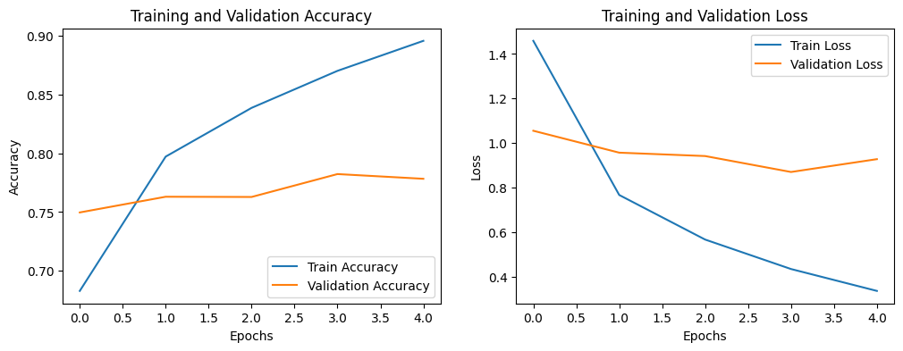
3. PLANT CLASSIFICATION MODEL
Plant classification model training process :
Figure 15. Plant classification model training process
Notes:
- The best model in training is at epoch 3, with the accuracy is 0.7824 evaluated on the validation set.

Slide 15
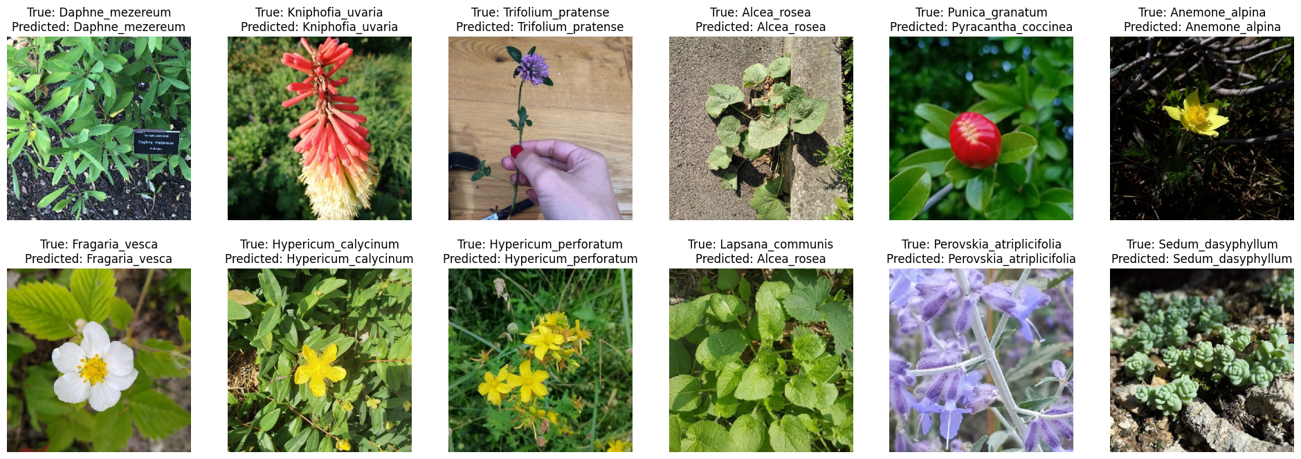
3. PLANT CLASSIFICATION MODEL
Results of the plant classification model:
The accuracy when evaluated on the test set is 0.7798
Figure 16. Results of the plant classification model

Slide 16
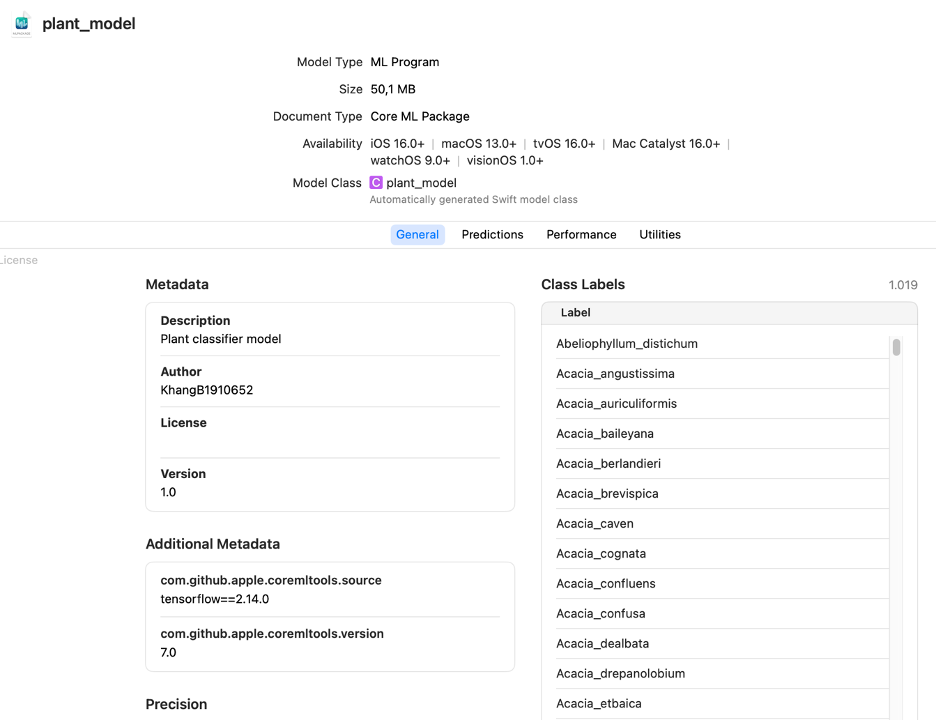
4. APPLICATION SYSTEM DESCRIPTION
Converting TensorFlow to Core ML:
Figure 17. General information about the Core ML model for plant classification

Slide 17
4. APPLICATION SYSTEM DESCRIPTION
Application demo:
Upload.
Classify plant.
View Wikipedia info.
View history.
View my plant.
I hope the teachers understand during the device setup process for system demonstration.
Notes:
- The homepage features a tab view that displays several plants in my plant list and three buttons: "Classify Plant," "View History," and "View My Plant".
- "Classify Plant" offers three options: selecting a photo from the library, taking a photo using the camera, and using live preview to see real-time predictions.
- The page displays predictions for the image, whether selected from the library or captured using the camera.
- The page shows information about the plant species from Wikipedia, comprising two sections in both English and Vietnamese.
- The user history page allows searching by the name of a previously predicted plant species. Clicking "Show more" reveals information from Wikipedia if the device is connected to the internet or swiping left displays the option to delete.
- On my plant page, users have the ability to access Wikipedia information offline.

Slide 18
5. PROPOSALS AND DEVELOPMENT DIRECTIONS
Proposals and development directions:
Use Inception V4 or Inception ResNet V2 to improve accuracy.
Use the PlantCLEF dataset with over 10,000 species.
Develop a cross-platform application using TensorFlow Lite, React Native, or Flutter.
Use Google Colab with paid resources to improve the model training speed.
Deploy in the app store on mobile platforms.
Notes:
However, fine-tuning numerous parameters is necessary to prevent the model from overfitting due to complex datasets.

Slide 19

I sincerely appreciate the following of esteemed teachers. Thank you!

